Slide 1
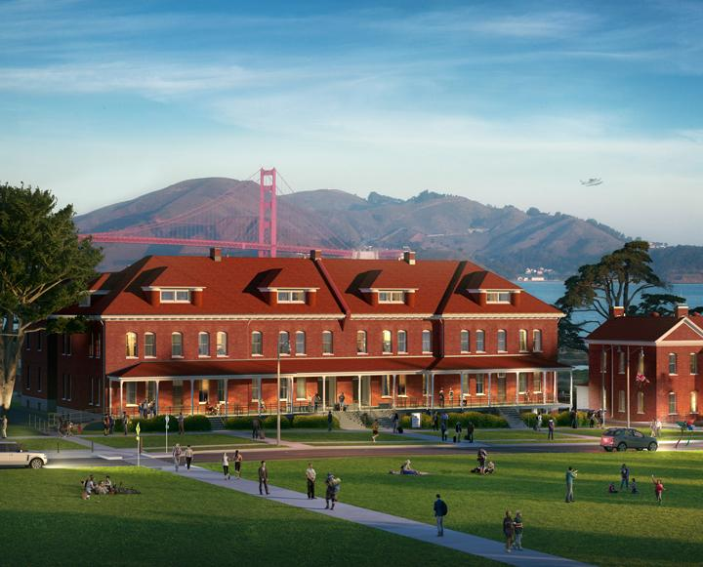
Addressing the Housing Crisis
Project Management of Affordable Housing Unit Construction in the San Francisco Bay Area
Analysts:
Christian Rodriguez | Flora Wong | Jeff Estrellanes | Patricia Ligon | Nancy Yuen | Gyati Mittal | Ankitaben Patel | Anshika Sharma
Notes:
Christian -

Slide 2

Introduction: Development of Affordable Housing Units
High cost of living + minimal amounts of inventory = SF Bay Area Housing Crisis

Slide 3

Introduction: Development of Affordable Housing Units
“Affordable Housing in the Bay by 2022”
CSU East Bay MBAs and entrepreneurs to develop affordable housing units
Deadline: 9/1/21

Slide 4


Project Scope
Objective
Affordable Housing Units in the San Francisco Bay Area under $500K
Deliverables
Completely build the sample 1852 SQ FT house by September 2021
Milestones | Completion Date
Service Blueprint | 2/16/2021
Zoning Approval | 4/20/2021
Carpentry | 5/14/2021
Plumbing | 7/6/2021
Inspection | 8/4/2021
Reflection, Lesson Learned | 8/5/2021
Technical Requirements
Meet building codes
Energy savings requirements
Earthquake proof
Limits and Exclusions
Specific design of the blueprint
M-F 8-5 PM, OT to discuss if needed
Notes:
Nancy Yuen

Slide 5
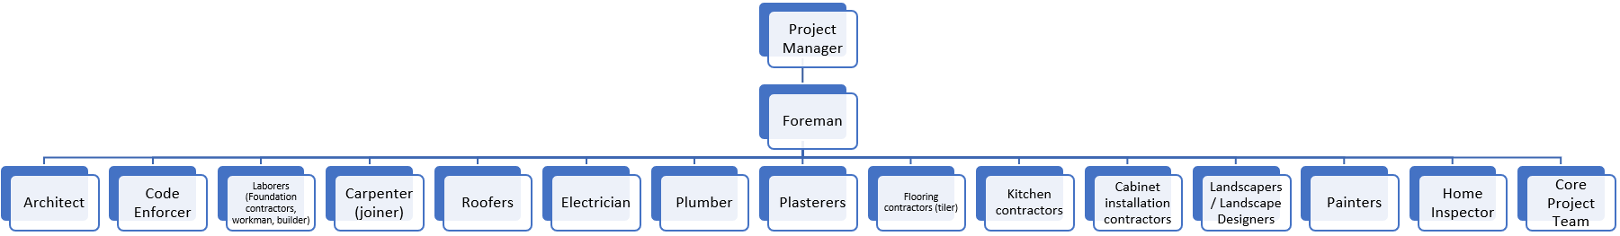
Project Planning: Project Organization Chart
Notes:
FLORA WONG
1. This is our project organization chart or project team.
2. We have a project manager overseeing monitoring and controlling the timelines.
3. Then we have the foreman who is in charge of a group of workers in different departments performing their tasks.

Slide 6
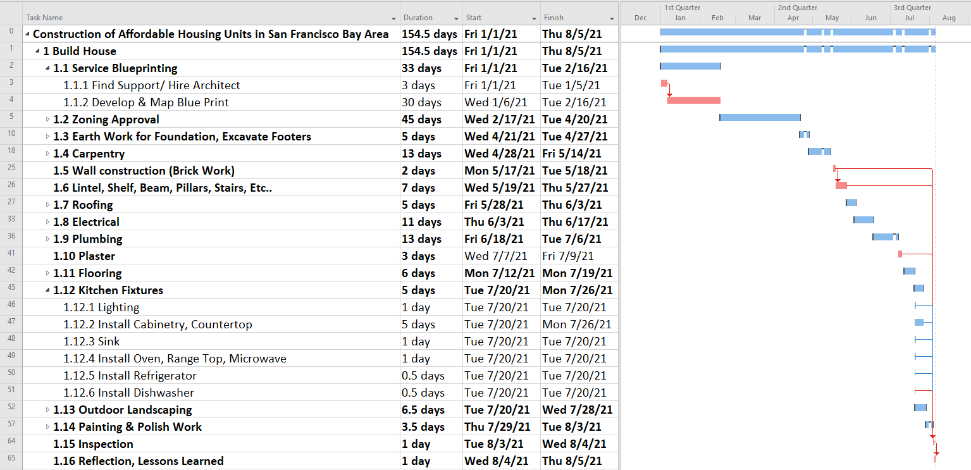
Project Planning:
Work Breakdown Structure (WBS)
Notes:
FLORA WONG
1. Most of the activities are conducted from finish to start
2. These activities happen in a series and have predecessors, so it must be completed in a certain order, for example you must have a blueprint created, before getting your permits approved.
3. We also have some activities that we revised to be parallel by using start-to-finish relationships.
4. For example, for kitchen fixtures, there can be different workers installing lighting, cabinetry, countertops, sink, oven, microwave, refrigerator, etc… all on the same day.
5. The activities in red are the critical path activities on the Gantt chart that we will monitor closely to ensure it meets our timelines.
6. Some of these activities have the longest duration like Service Blueprinting which takes 33 days and Zone Approval which takes 45 days.

Slide 7
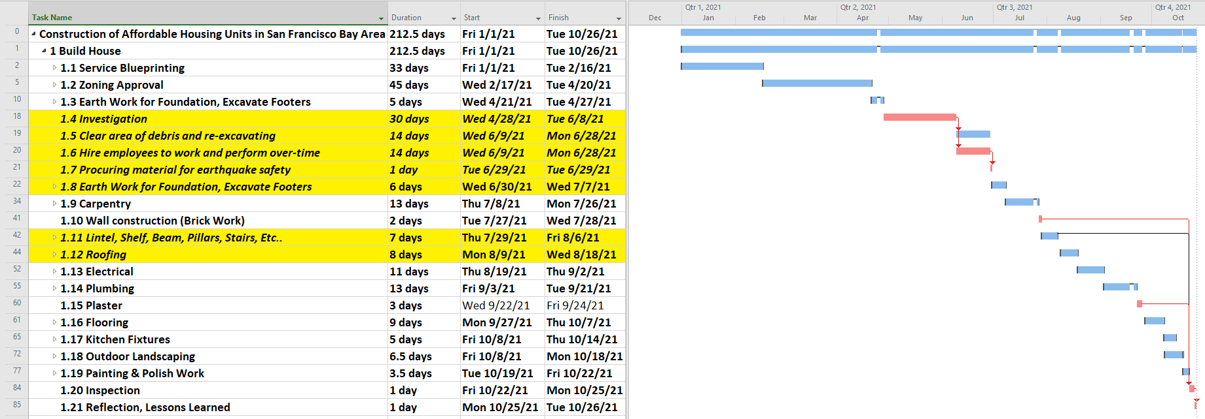
WBS After Natural Disaster
Notes:
FLORA WONG
1. The natural disaster caused close to a 3 months delay in our timeline.
2. Original timeline was to complete the project on 8/5/2021 and now it is 10/26/2021 (82 days delay).

Slide 8
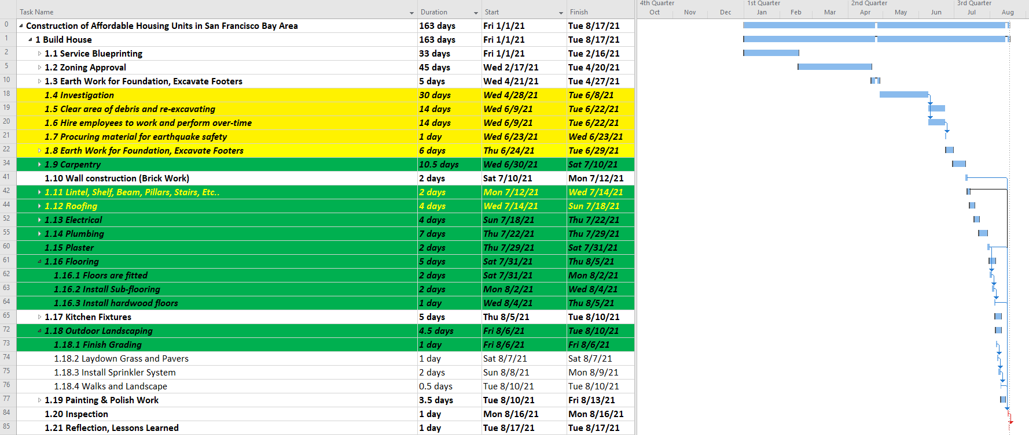
Project Planning:
Revised WBS & Gantt Chart with
Contingency Plans Implemented
Notes:
FLORA WONG
After the natural disaster, we had to add in activities like Investigation, hire new employees to work overtime on weekends, clean debris, rebuild building using more earthquake resistant materials to strengthen structure (i.e steel ground beams, strong moment connections, columns designed to resist loads, fix the main beams, lightweight conventional cladding is fitted to the frames, lightweight or thin concrete roofs are fitted) to WBS. Highlighted in yellow.
The activities highlighted in red on the gantt chart are the critical path activities. Since this is a time-constrained project, we had to smooth our resource demand.
If things can happen in parallel like Clear area of debris and re-excavating, and hire employees to work and perform over-time, we made that happen.
By having workers work on the weekends and crashing some activities highlighted in green we were able to pull the schedule up by 2 months from 10/26/2021 to 8/17/2021 (70 days).

Slide 9
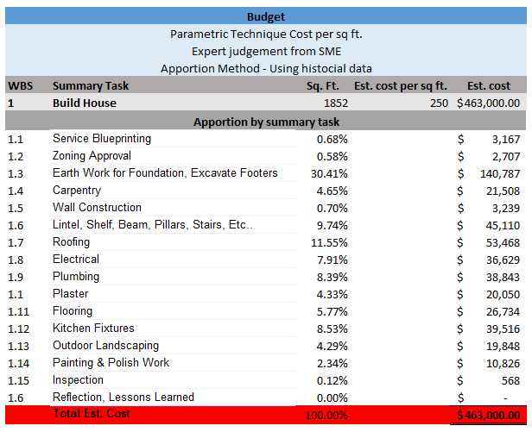
Notes:
PATRICIA LIGON
Specify areas you want to mention especially when you have a table with a lot of numbers to ensure you get everyone’s attention. Focus on most interesting topics/ humorous items

Slide 10
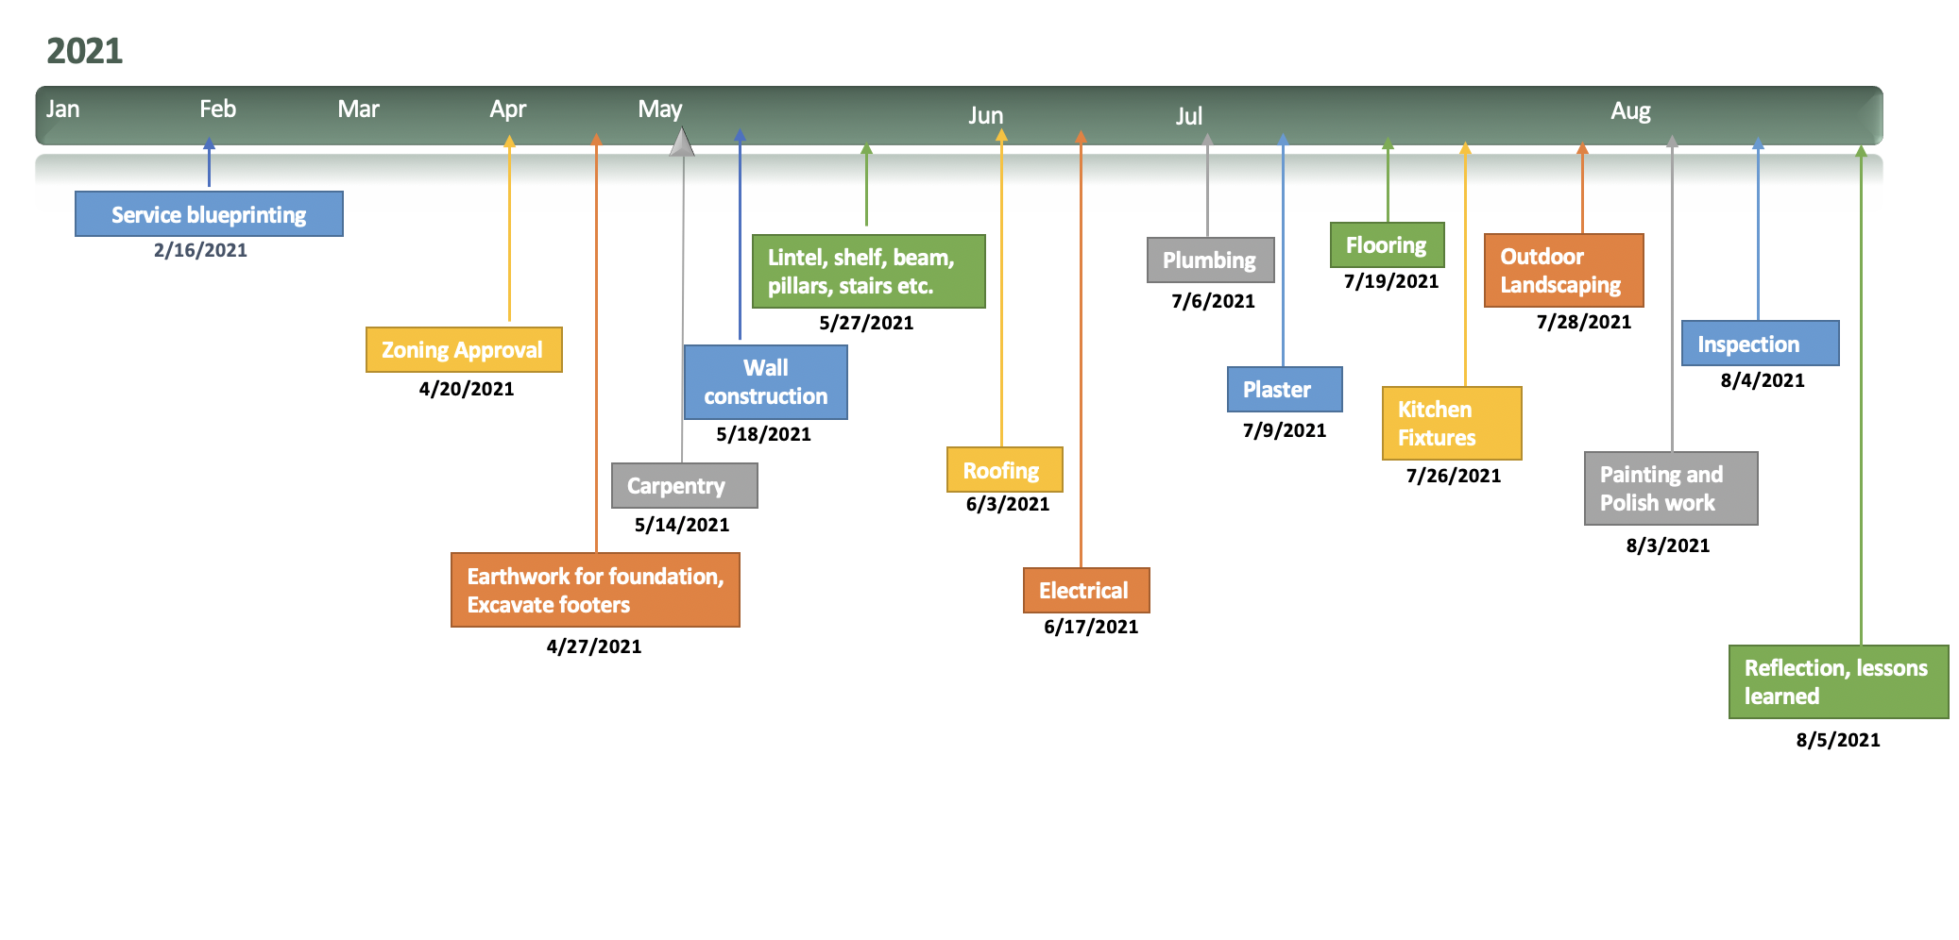
Project Planning: Timeline (Before Natural Disaster)
Notes:
ANKITABEN PATEL

Slide 11
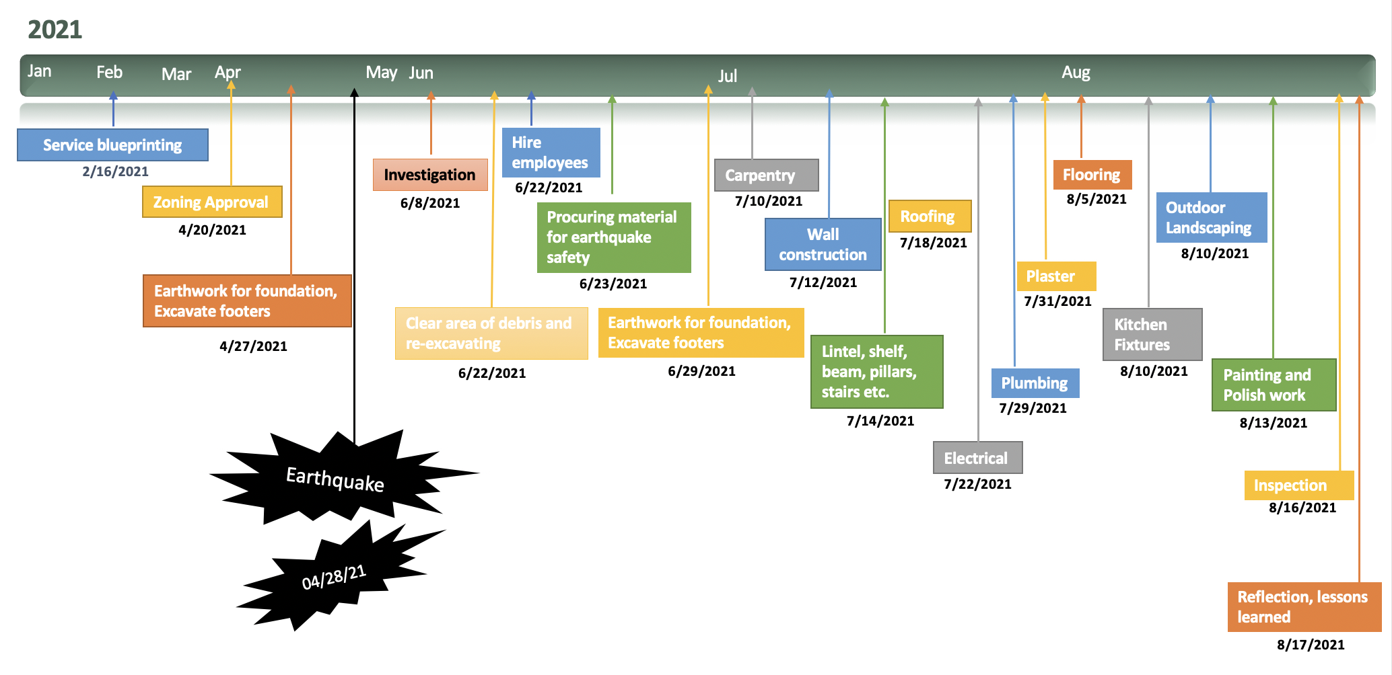
Project Planning: New Timeline with Crashing activities
Notes:
If you want to explain certain things use a pointer or enlarge the letters to help people understand. Helps audience to

Slide 12

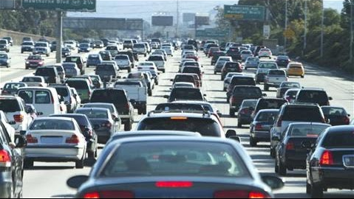
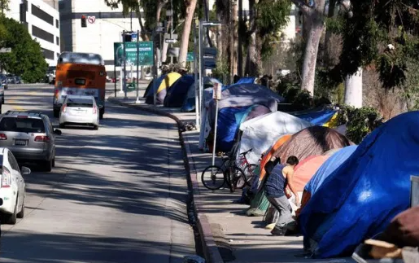

Project Executing: Technical Challenges
Environmental challenges:
Congested areas with poor air quality
due to cars and trucks
Industrial areas
Space Issues:
Overcrowding
Lack of housing
and homelessness
Crime Issues:
Families prefer safe neighborhoods
Families prefer neighborhoods with good schools
Notes:
GYATI -

Slide 13
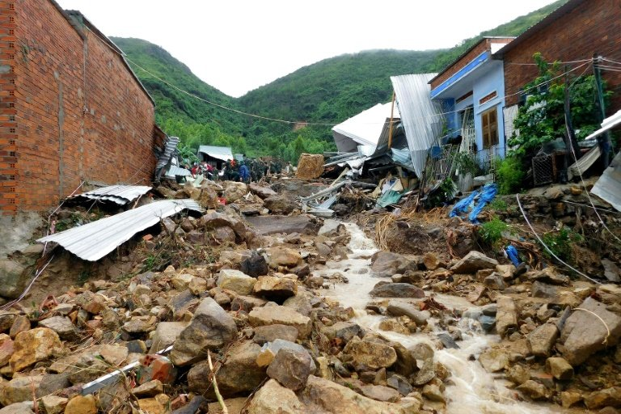

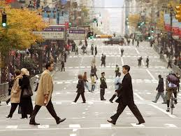
Project Executing: Technical Challenges
Unsuitable Areas:
Areas in close proximity to the ocean
Flooding
Areas in mountainous or forested areas
Access, Fires, Landslides.
Bureaucratic Challenges:
Disapproval of licence/permit
Problems due to new housing plans.
Commute challenges:
Walk score
Access to mass transit
Access to major thoroughfares / highways / airports
Notes:
GYATI

Slide 14
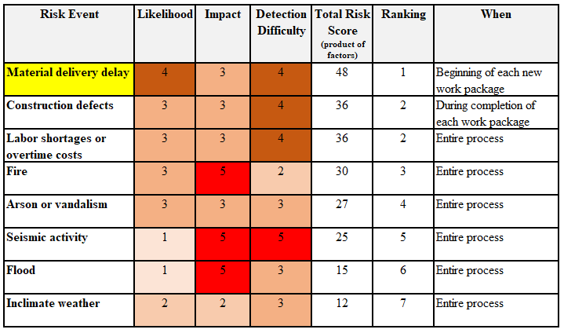
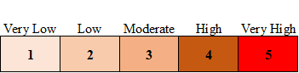
Project Executing: Initial Risk Assessment
Notes:
JEFF ESTRELLANES
Material delivery was our highest risk event with a total risk score of 48, the product of likelihood, impact and detection difficulty

Slide 15
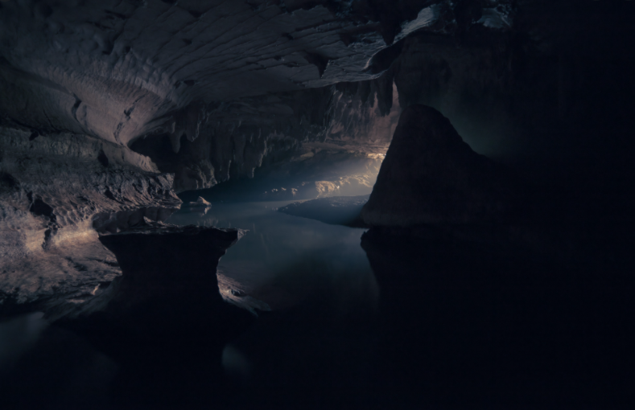
Project Executing: Caverns and Fault Line Discovered
Fault!
Notes:
JEFF ESTRELLANES
1.3 - 4/21/20 Upon excavation, we discovered underground caverns and a fault

Slide 16
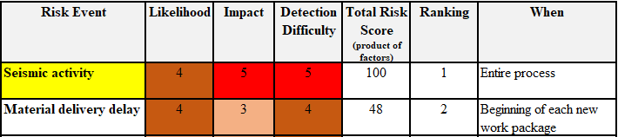
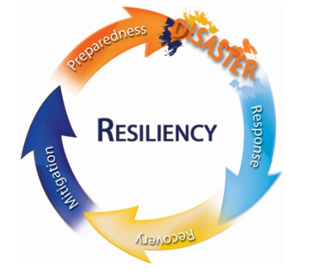
Project Executing: Post-Fault Discovery Risk Assessment
Develop Risk Response and Contingency Planning
Notes:
JEFF ESTRELLANES
We had to reassess our risk assessment
Seismic activity score for likelihood increased from 1 to 4
However, we accept the risk and worked on mitigation

Slide 17
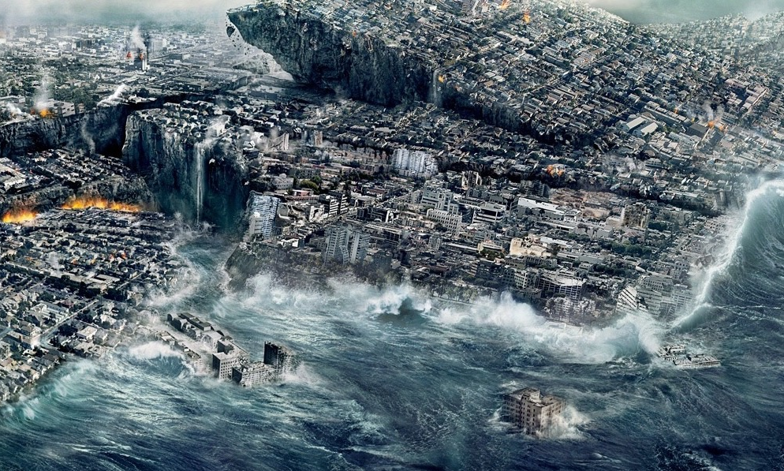
Project Executing: Extraordinary Event
April 28, 2021
Notes:
JEFF ESTRELLANES
The earth rumbled. The earth crumbled. The earth shook. That is all it took.
7.7 on the richter scale. Would our project fail?
Wait - I did mention we had a well defined and developed contingency plan right?
Christian - How well were we prepared and how did we respond?
1.3
(song: It’s the End of the World as we Know It - 45 seconds)

Slide 18

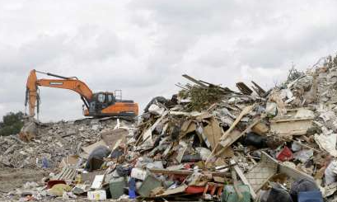
Project Executing: Contingency Plans / Response
Investigate damage
Clear area of debris
Begin the reexcavation process
Procure the materials needed to rebuild
Hire employees
Develop a schedule including work weekends
Begin the rebuilding process from step 1.3 Earth Work for Foundation
Excavate footers with new earthquake safety in mind
Adhere to the WBS in order to meet all of the deliverables and sub deliverables in place prior to the risk event
Notes:
CHRISTIAN

Slide 19

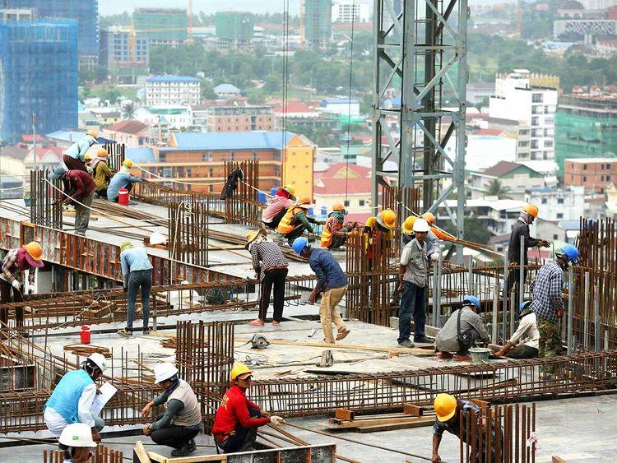

Reducing Project Duration (Project Crashing)
Completion date after earthquake : Oct 26, 2021 (212.5 days)
Completion date after crashing : August 17, 2021 (163 days)
Accelerated by 70 days
Reason for crashing: to meet the deadline
By reducing duration of tasks and including weekends.
Additional Cost : $50,172
Notes:
Anshika Sharma

Slide 20
Table representing the distribution of normal and crash cost
Task No. | Task name | Predecessors | Normal time | Maximum crash time | Normal cost | Crash cost | Additional cost
1.9 | Carpentry | Earth work for foundation, Excavate footers | 13 days | 2.5 | 14,504 | 18,976 | 4,472
1.11 | Lintel,shelf,beam, pillars,stairs,etc | Wall construction | 7 days | 5 | 36,619 | 39,619 | 3,000
1.12 | Roofing | Lintel,shelf,beam, pillars,stairs,etc | 5 days | 1 | 25,000 | 29,000 | 4,000
1.13 | Electrical | Roofing | 11 days | 7 | 16,000 | 30,000 | 14,000
1.14 | Plumbing | Electrical | 13 days | 6 | 15,000 | 28,000 | 13,000
1.15 | Plaster | Plumbing | 3 days | 1 | 40,000 | 45,000 | 5,000
1.16 | Flooring | Plaster | 6 days | 1 | 14,400 | 19,400 | 5,000
1.18 | Outdoor landscaping | Kitchen fixtures | 6.5 days | 2 | 20,340 | 22,040 | 1,700
 | Total Additional cost |  |  |  |  |  | 50,172
Reducing Project Duration cont.
Notes:
Anshika Sharma - Make the font bigger for people to be able to read it. We need to pretend that we are the audience.

Slide 21
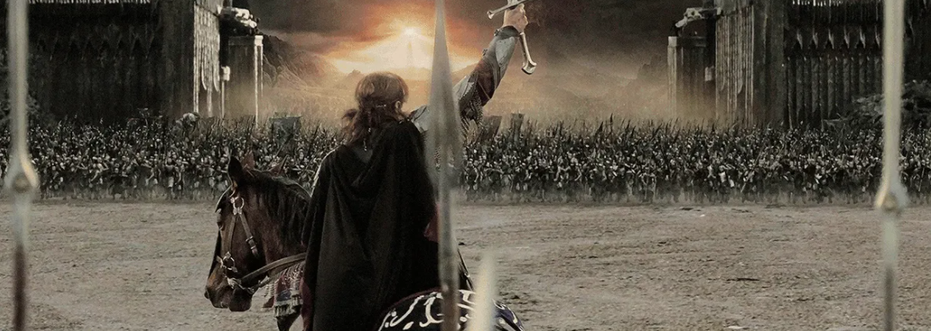
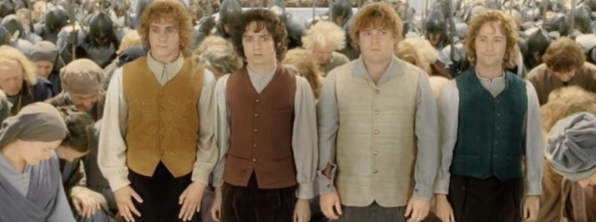
Lessons Learned
“Short cuts make long delays.” ― J.R.R. Tolkien, The Fellowship of the Ring
“When the pressure is on, you don't rise to the occasion—you fall to your highest level of preparation” ― Chris Voss
“Persistence and resilience only come from having been given the chance to work through difficult problems.”― Gever Tulley
Notes:
JEFF ESTRELLANES
Quote 1: take time to do project plan, communication
Quote 2: identify risks and perform risk assessment / contingency plans, and adjust as necessary
Quote 3: when the going gets tough, focus on critical path activities and crash to reduce duration when you can. together - yes we can.
(song: Lord of the Rings song - 2:28)
Hand off to Christian for finale

Slide 22


Conclusion
Successful Project!
Deadline Met: September 1, 2021
Notes:
CHRISTIAN
(song: celebrate good times - from beginning)

